Slide 1
Automated Lighting System Using Person Detection
M. Abubakar
2021-CS-171

Slide 2
Agenda
01
02
03
Project Description
Communication with owner
Meeting minutes
04
05
06
Github
Technology stack
Wireframes
07
08
09
Frontend
Backend
Coding best practices
10
11
Database schema
Project features

Slide 3

Overview
Quick pall is a digital platform that enables users to send, receive, request, and manage financial transactions electronically.

Slide 4
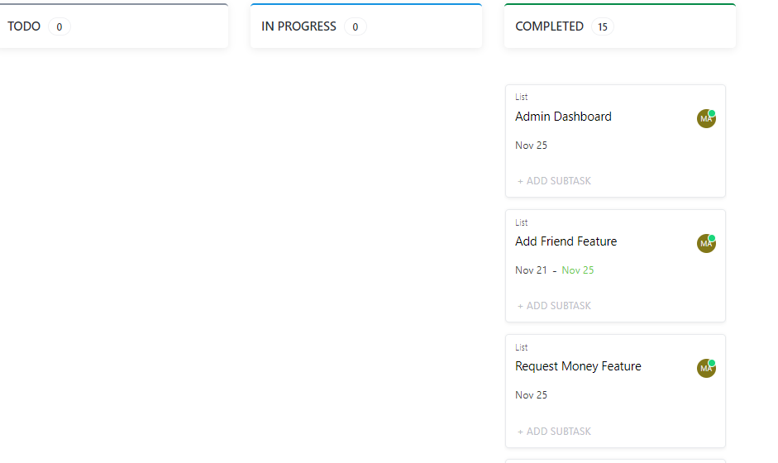
Project Management Tool
1
I use Clickup for managing my project

Slide 5
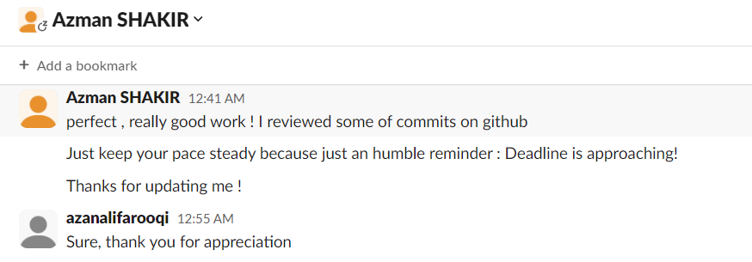
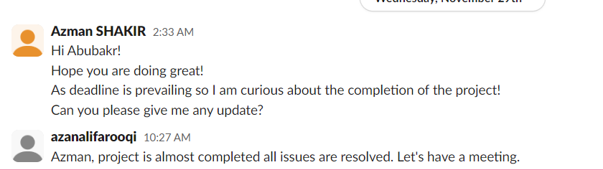
Communication with Owner
I chose Slack for communication with the owner because of its user-friendly interface and robust collaboration features, allowing for seamless and organized discussions

Slide 6
Meeting Minutes
Meeting 1
Duration: 30 minutes
Date: Sep 14, 2023
Location: Lab 1 CS Department, UET Lahore
Agenda: Discussion on functional requirements such as Signin, Signup, OTP verification e.t.c
Meeting 2
Duration: 30 minutes
Date: Sep 28, 2023
Location: Lab 1 CS Department, UET Lahore
Agenda: Approval of Database design, Wireframes and changes in functional requirements
Meeting 3
Duration: 30 minutes
Date: Nov 22, 2023
Location: Lab 1 CS Department, UET Lahore
Agenda: Approval on Database changes, Admin dashboard feature and completed work

Slide 7
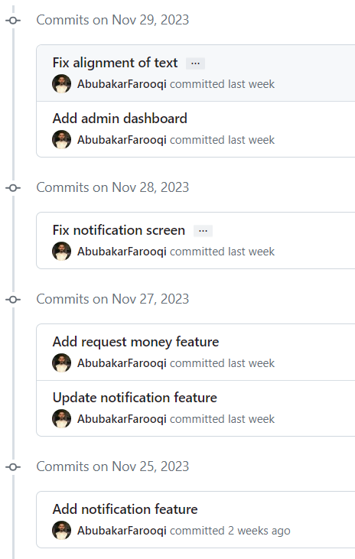
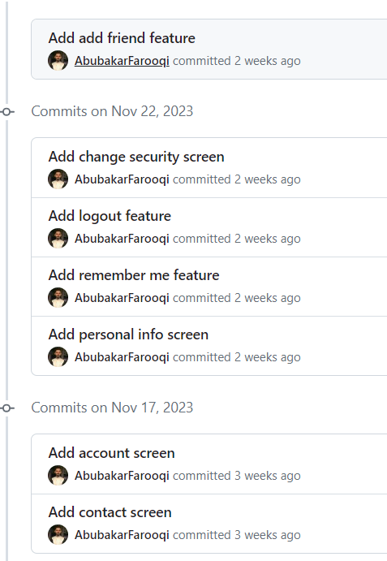
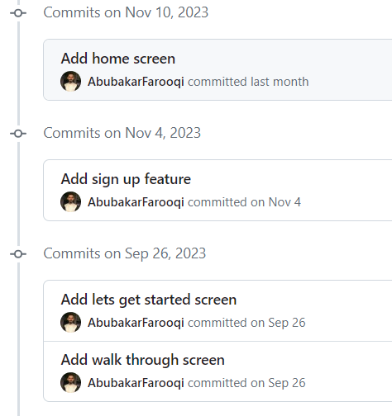
Github: Commits
Total commits = 23

Slide 8
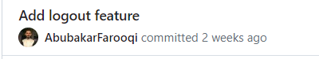
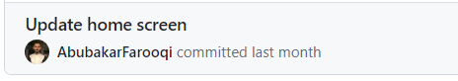
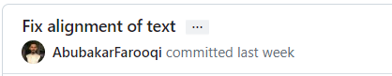
Github: Commit Style
Commit styles for:
Add
Update
Fix

Slide 9
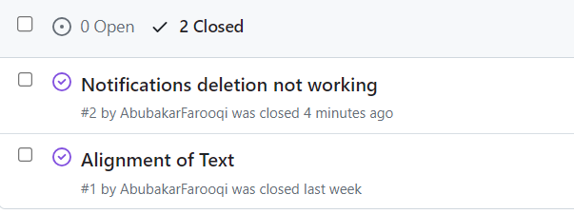
Github: Issues
Open two issues
Close them by applying fix

Slide 10
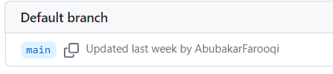
Github: Branches
Only one branch main

Slide 11



Technology Stack
Frontend
Flutter framework
Backend
Firebase
Development Tool
Dart programming language

Slide 12
Technology stack: Reason
Learn flutter framework
Owner’s requirement
Mobile app development course
Handle workload

Slide 13
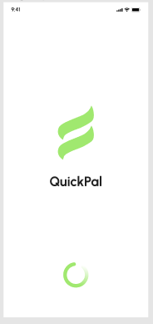
Wireframes
Splash Screen

Slide 14
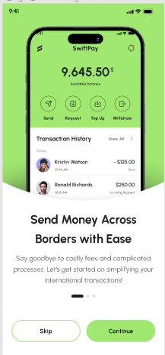
Wireframes
Walkthrough screen

Slide 15
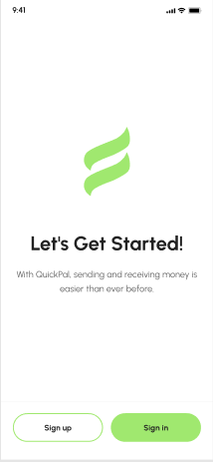
Wireframes
Get started screen

Slide 16
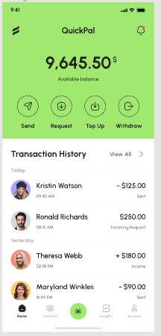
Wireframes
Home screen

Slide 17
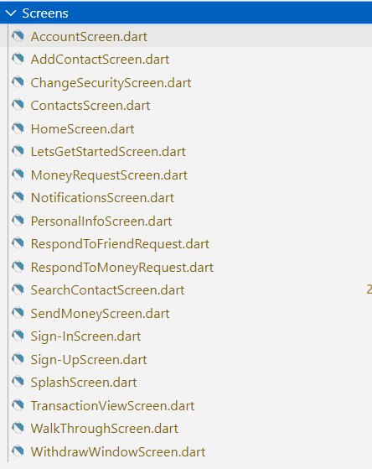
Frontend

Slide 18
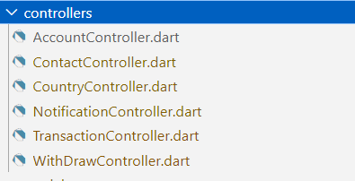
Backend

Slide 19
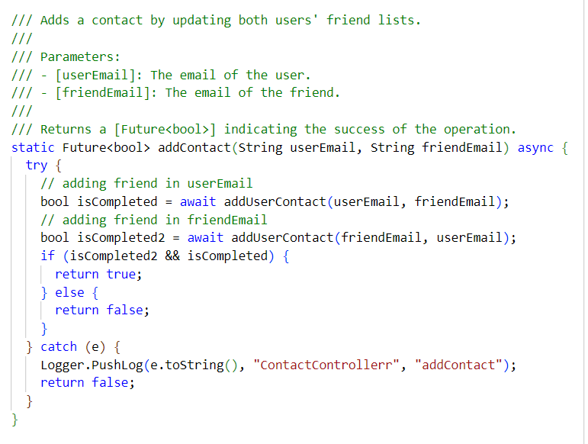
Coding Best Practices: Comments
Documentation comment style

Slide 20
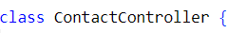
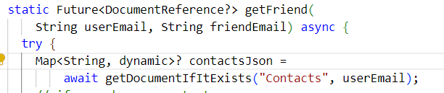
Coding Best Practices:
Naming Convention
camelCase for variables.
camelCase for functions.
PascalCase for classes.
These naming convention are according to dart guidelines.
Dart documentation | Dart

Slide 21
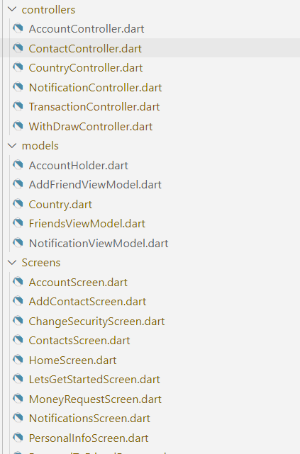
Coding Best Practices:
Project Structure
Controllers.
Models.
Screens.

Slide 22
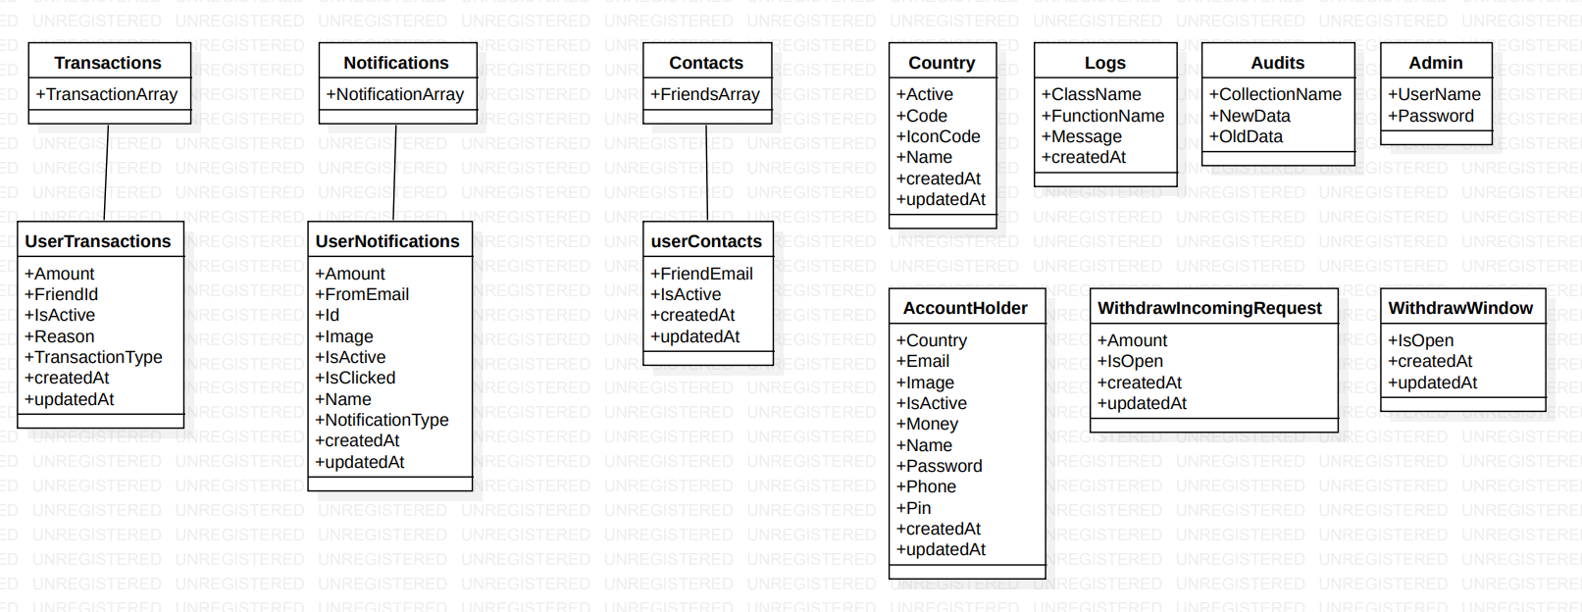
Database Diagram

Slide 23
Project Features
Signup user
Signin user
OTP verification
Send money
Request money
Withdraw money
Send friend request
Remember me
Change password
Change pin
Change image
Change name
Notification
Withdraw authentication
Transactions management
Admin dashboard

Slide 24
Thank You!

